Slide 1

PIZZA SALES
“2015” RECORD

Slide 2
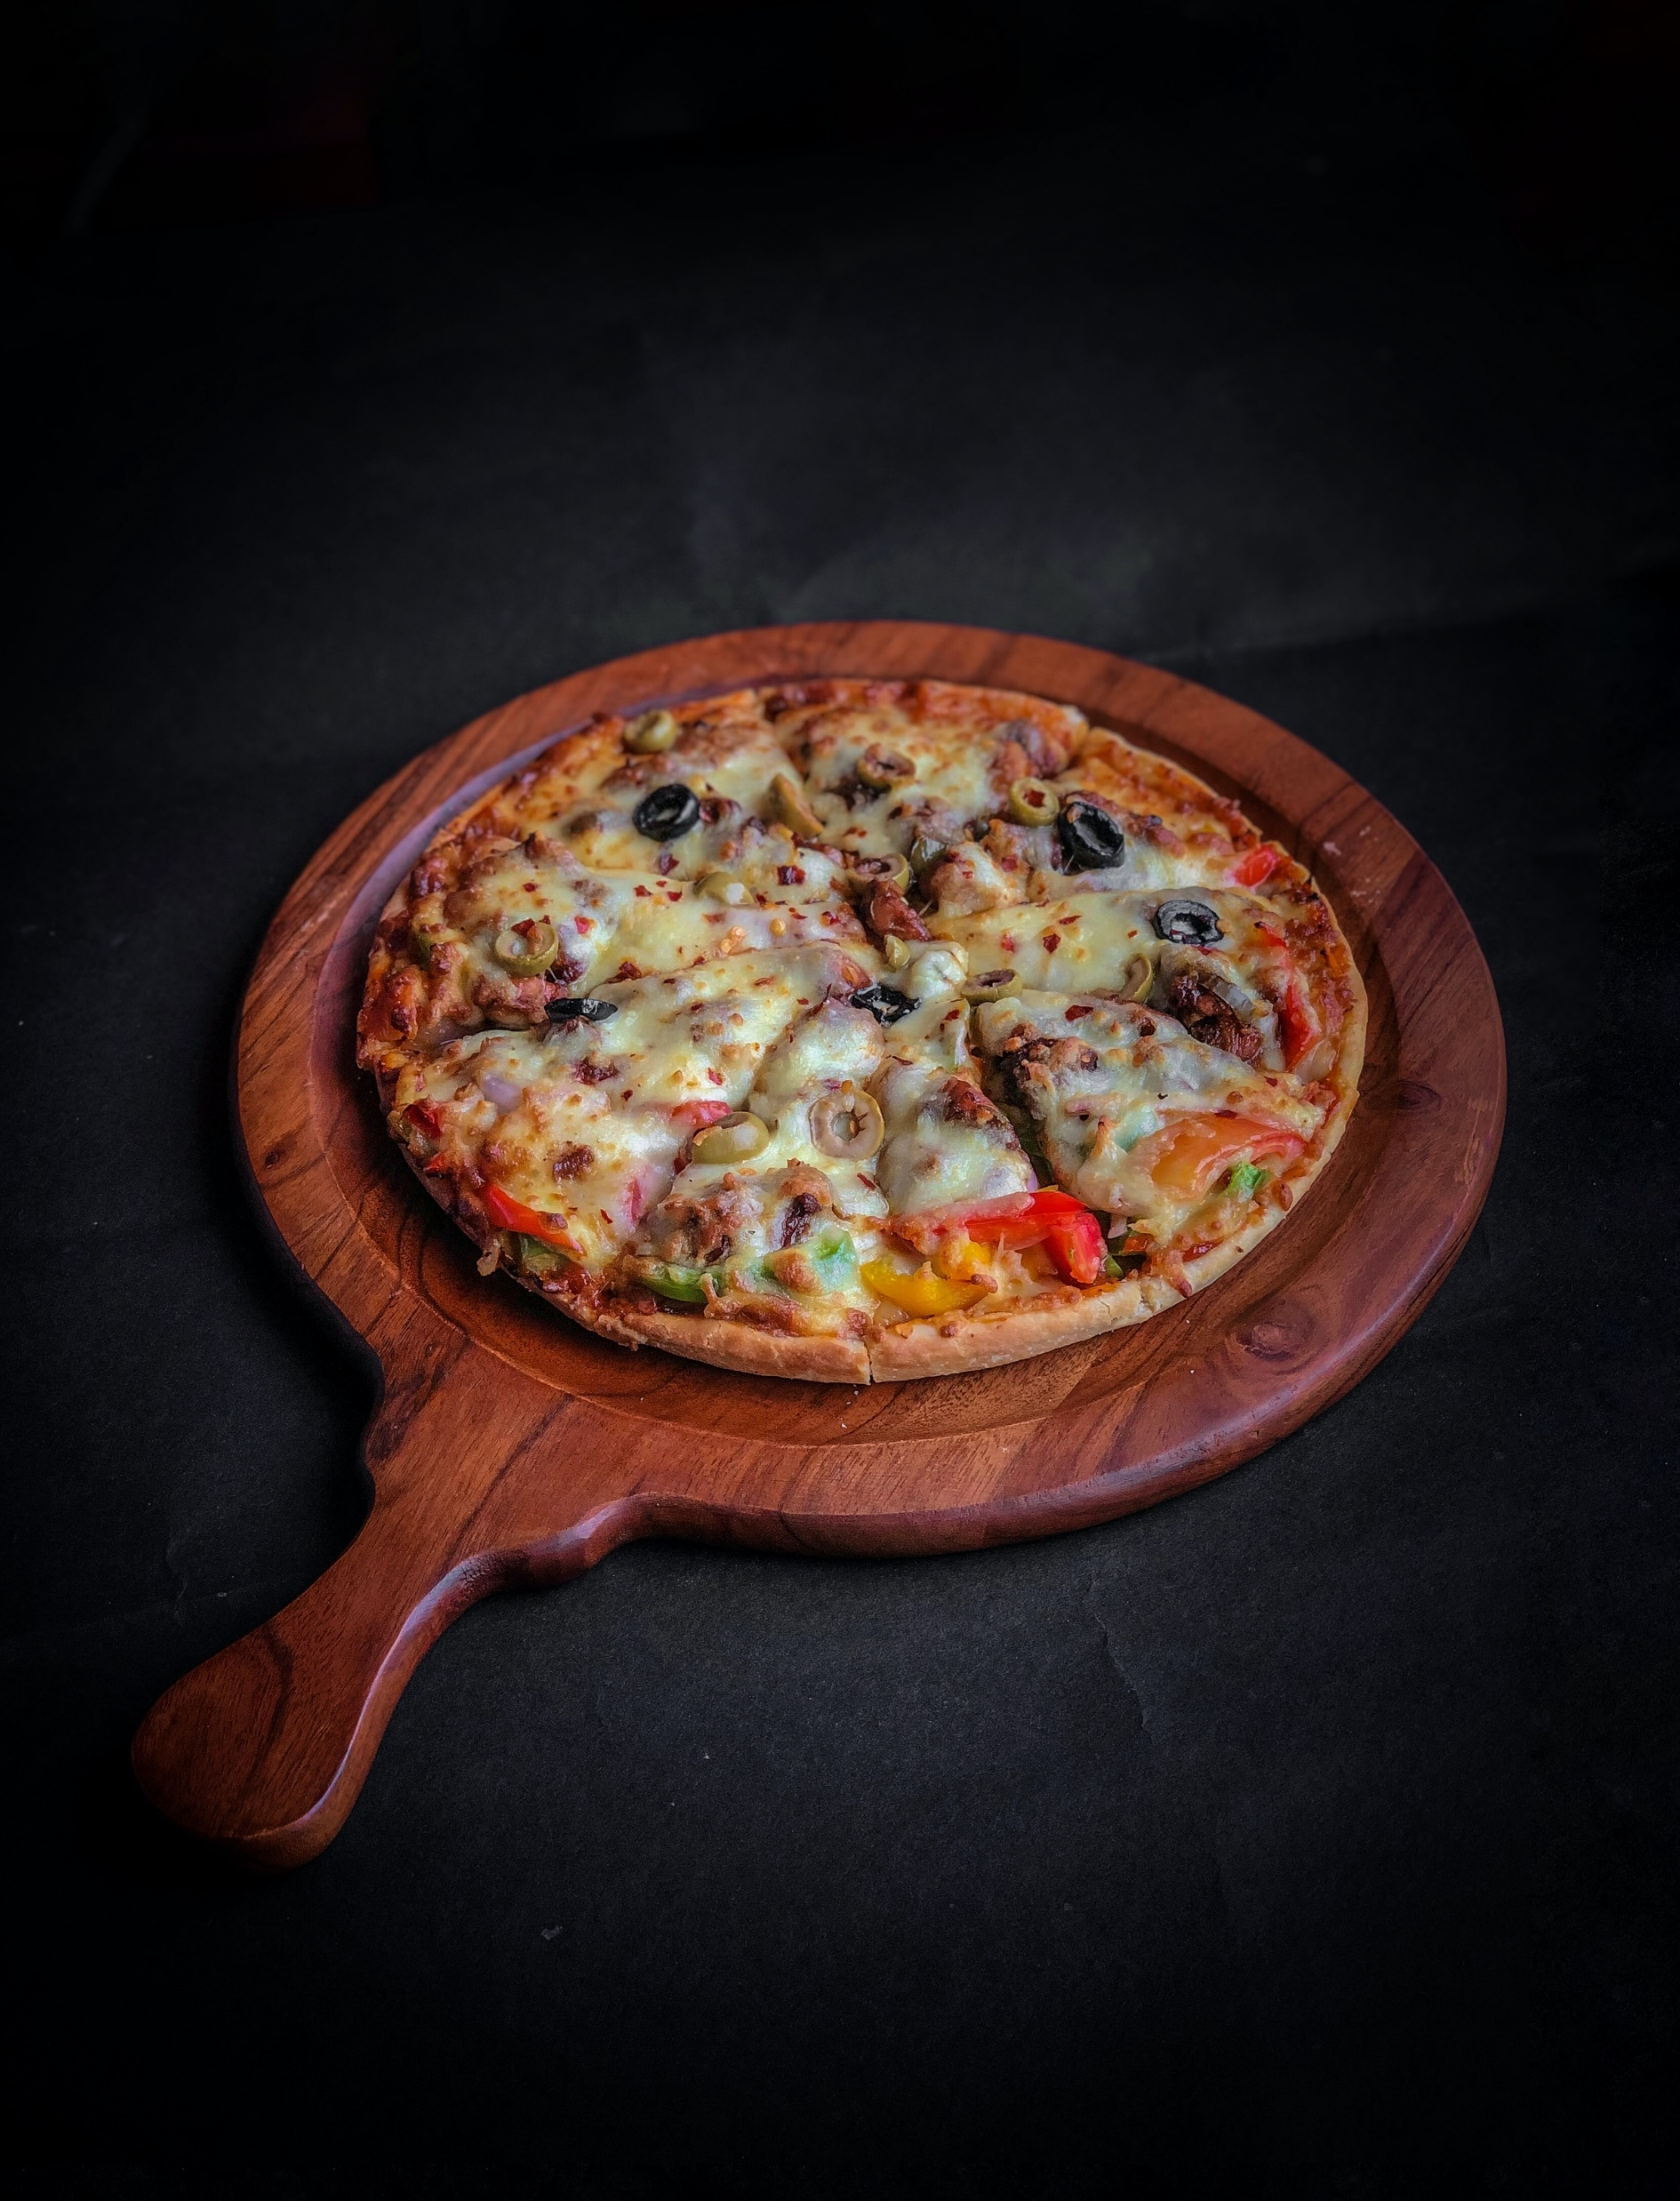


Slide 3

ABOUT DATASET
This Dataset Shows About The information about pizza ,pizza type ,where and how many orders are placed and also a additional details about quantity, prize and ingredients.
This dataset also tells about that how many customers visit, which pizza is the bestseller & how much sales is carried in the year of 2015.
This dataset is quite tactical and is solved by the source “Maven Analytics”

Slide 4
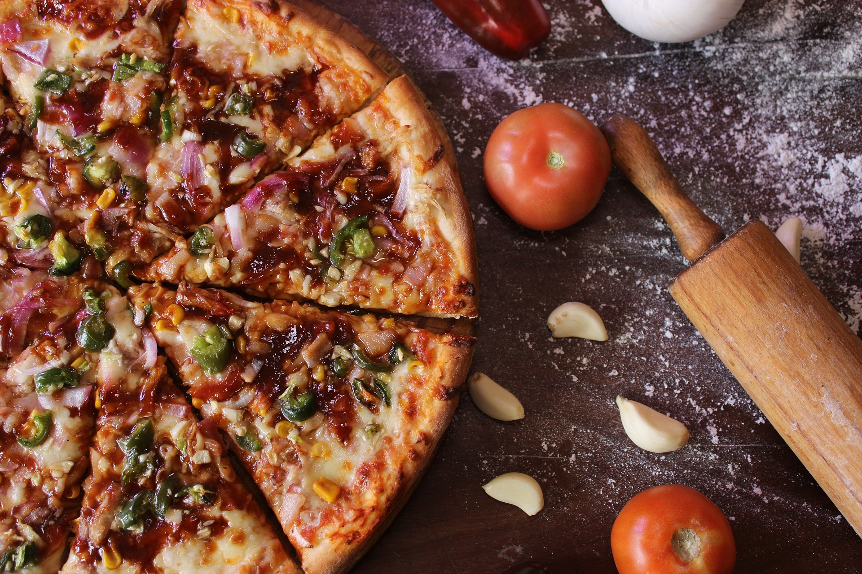
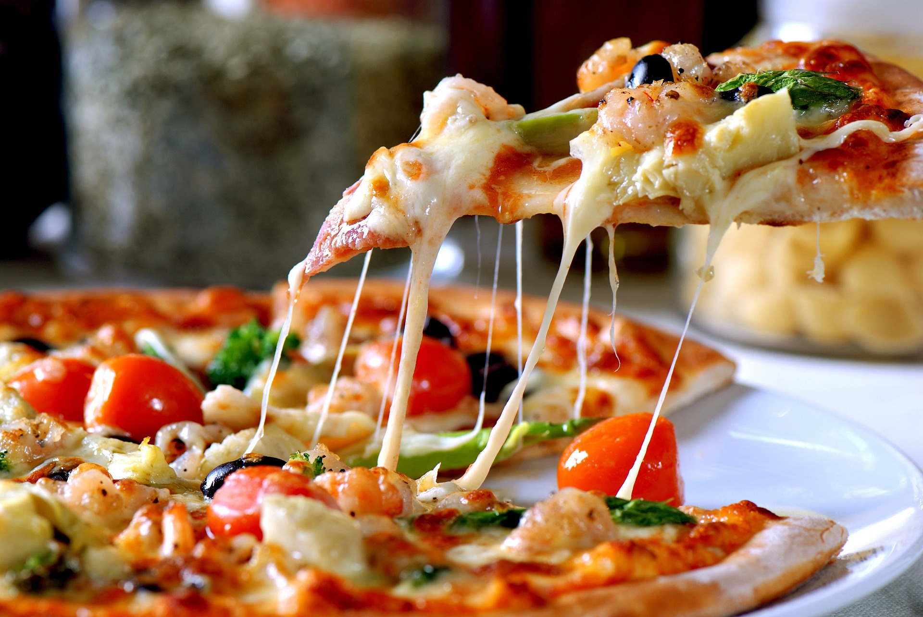
METHODOLOGY AND PROJECT SCOPE
Step 1 :Firstly, you have to carry out the data dictionary from the source which includes 4 different table, different fields with its description.
Step 2 :According to this data dictionary, we can solve the recommended analysis part from the other dataset provided.
Step 3 :For execution of calculations part we need primary data, for this a data window is presented which collects the data for customer orders details, pizzas types, date, time, size and price of pizzas and then, calculations are carried out on excel.
Step 4 :From each data collected we can make required pivot table from it and use excel functions to solved the calculation part and then create a understanding pivot charts for the recommended analysis part of this project to provide solution.
Step 5 :Hence, a dashboard is prepared in which all the recommended analysis part is calculated and solved in excel.

Slide 5
In 2015, We have found a Major changes in month of October (12.32%), November (14.76%), December (15.12%). Therefore, "oct-no”-dec" are been identified as an seasonality in sales

Slide 6
By Counting and Averaging the Order details id and Orders id, we come to know that there are typically 3 pizzas in order…. PEAK HOURS ARE BETWEEN : 12 PM - 1 PM & 5 PM - 7 PM

Slide 7

GOALS & KPIs : Goal 1: Making a sales data understandable. Goal 2: Can calculate the peak hours, bestsellers and seasonality of pizzas from the data. Goal 3: It can calculate the revenue of any pizza place from its sales data
f EXCEL CONCEPTS USED : 1.COUNT, AVERAGE 2.SUMPRODUCT 3. NESTED SORTING 4. NESTED FILTER 5. PIVOT TABLE, GROUPING 6. MAX, MIN

Slide 8
CONCLUSION
This data can be beneficial for customers, as they can make informed decisions about every order based on the popularity and company's overall sales performance.
Therefore, it helps the customer to know the insights of that company if such kind of data is provided.

Slide 9
Thank you
Project owner :
NITIN KUMAR

